Slide 1
Datagrok Dev Meetings
GDM1: Getting Started
May 8th, 2020
https://datagrok.ai
https://community.datagrok.ai/t/gdm-1-the-beginning

Slide 2
Datagrok: an operating system for data
Developers can take complete control of the platform, leverage and extend the ecosystem. Why would you ever start from scratch?
High-performance data engine
Blazingly fast visualizations
Data connectivity
Scientific computing
Data science, ML and AI
Data augmentation
Collaboration
Security, audit, backups, scaling, etc
https://datagrok.ai/help

Slide 3
Extending the platform
Types of extensions
First-class functions
Cross-language support
Packages and repositories
JS API
Dev environment

Slide 4
Types of extensions
Function
Cell renderer
Predictive model
Database query
Interactive viewer
Parameter validator
Statistical analysis
Python script
SPARQL query
Web service
Jupyter notebook
Data augmentation
Application
Bioinformatics
Auto-completer
File viewer
File validator
Aggregation method
…and a lot more. Each extension is a function, and many of them could be
written in any supported language!

Slide 5
First-class functions
Metadata
Registry
Inspection
UI generation
Logging, interception
Caching results
Security
Dynamic discovery
Audience targeting

Slide 6
Cross-language support
Functions can be written in any supported languages
Python, R, Julia, Node.js
Inputs get sent to the “compute” server
Support for Conda environments
JavaScript
Gets executed right in the browser
Has access to JS API

Slide 7
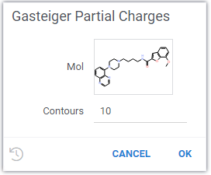
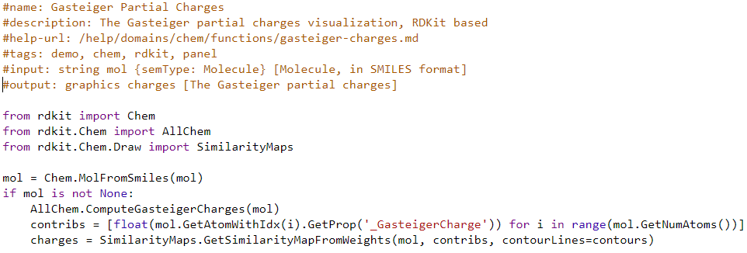
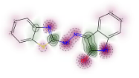
Example: Gasteiger Partial Charges
GPC(string/Molecule): graphics
GPC( ) ) =

Slide 8
Packages and repositories
Git integration
One-click deployment
Version control
https://github.com/datagrok-ai/public
https://datagrok.ai/help/develop/develop#packages

Slide 9
Package structure
/scripts/
/swaggers/
/connections/
/queries/
/files/
/css/
/js/
package.json
package.json
package.png
setectors.js

Slide 10
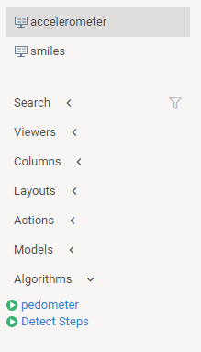
Example: Pedometer
detector.js: inspects newly opened tables, marks column with semantic types
detect_steps.py: detects step positions from the raw accelerometer script
Package.js: exposes a couple of JavaScript functions annotated in a special way (calls detect_steps.py in the process)
Datagrok puts it all together
https://github.com/datagrok-ai/public/tree/master/packages/Pedometer

Slide 11
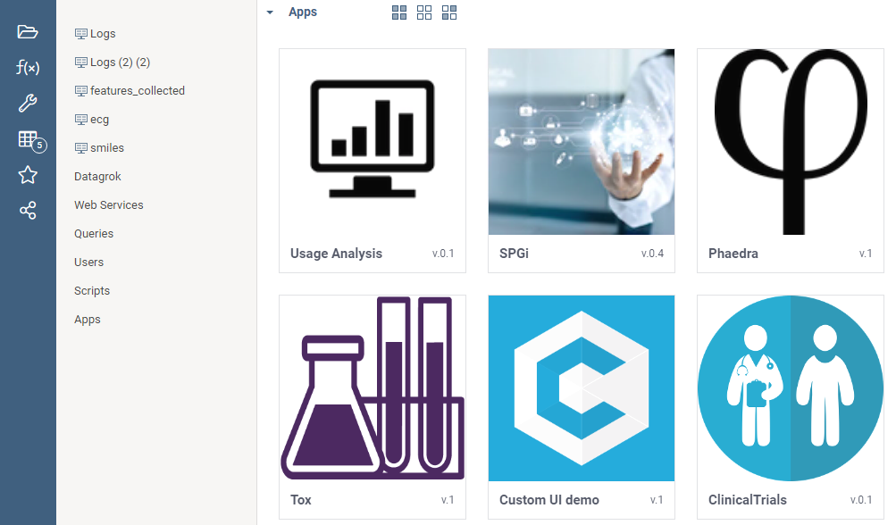
Apps
App is a function annotated with the “app” tag

Slide 12
JS API
Functions, applications
Full control over everything
Access to low-level details if needed
BitSet, DataFrame, etc
100+ executable snippets: https://public.datagrok.ai/js
https://datagrok.ai/help/develop/develop

Slide 13
A new way to develop applications
Web-based, fast and lightweight
For typical cases, traditional data access layer services no longer needed
Managed connections to databases, etc
Support for statistics, data science, ML, AI
Modular
Manageable on a component level (usage analysis, impact analysis, role management)

Slide 14
Dev Environment
API Key
SDK
Package templates
Demo: from zero to debugging a JS package in 4 minutes https://youtu.be/PDcXLMsu6UM

Slide 15
Thank you!
Platform: https://datagrok.ai
Community: https://community.datagrok.ai
Public repository: https://github.com/datagrok-ai/public
Help: https://datagrok.ai/help
YouTube: https://www.youtube.com/channel/UCXPHEjOd4gyZ6m6Ji-iOBYg *
* Need 100 subscribers for a shorter link so please subscribe! ☺

